Slide 1

Battle of the Neighbourhoods
Choosing an Ideal Location to Open a New CrossFit Box

Slide 2
Background
CrossFit is a class of fitness philosophy and lifestyle founded in the year 2000 by Greg Glassman and Lauren Jenai. It has grown in popularity over the last 20 years and has become an international competitive sport. It is described as ‘Functional Fitness’ and incorporates Olympic weightlifting, high-intensity interval training, gymnastics skills, powerlifting, calisthenics, among other disciplines, and is designed to bring a dramatic uptake in fitness and strength with a feeling of comradery as it is practiced in groups with the leading of a qualified coach.

Slide 3
Factors for consideration
Average income of Neighbourhood
Does this neighbourhood already have a CrossFit Box?
Does the neighbourhood show an interest in sports or health & fitness?

Slide 4
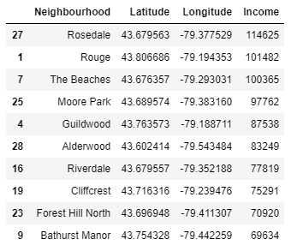
Data Analysis
Initial Results of Data Analysis in Jupyter Notebook
From these results I was able to select the top 5 Neighbourhoods to consider as appropriate locations.

Slide 5
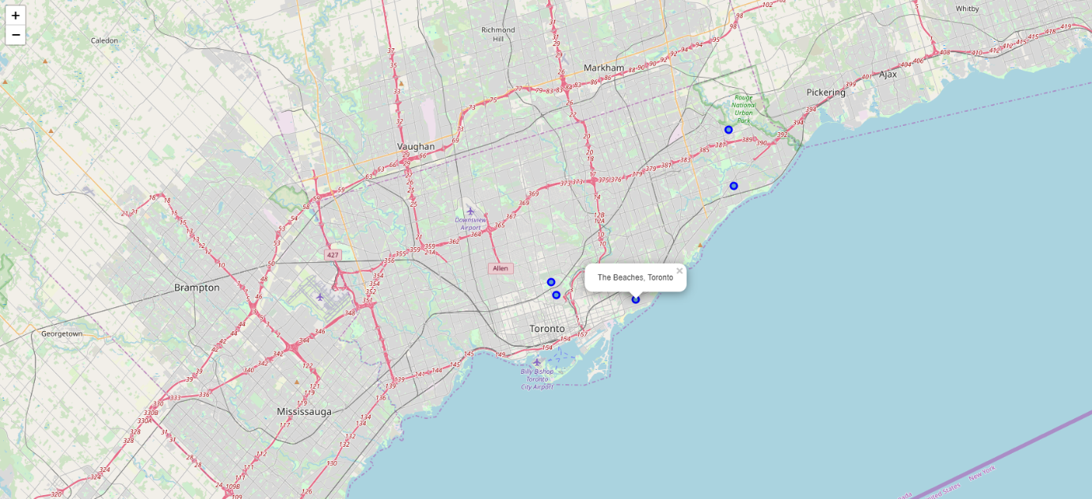
Folium Map of Neighbourhoods

Slide 6
Foursquare Results
After running a query using Foursquare to find out whether any of the 5 Neighbourhoods already had a CrossFit Box, I returned the following results:
I was able to shortlist two final Neighbourhoods for recommendation, namely:
Rouge
Guildwood
Neighbourhood | CrossFit Box
Rosedale | Yes
Rouge | No
The Beaches | Yes
Moore Park | Yes
Guildwood | No

Slide 7
And the Winner Is:
I ran a further query in Foursquare to discover which of these two Neighbourhoods showed an interest in sports or fitness related recreational activities, and the outcome was that Guildwood, Toronto, C.A. was recommended to my client as the ideal location to open a new CrossFit Box.

